Slide 1

Cache Memory using 4T SRAM
Project guide : Kirti S Pande
Department : ECE
Date : 7th March, 2013.
Team members
Sai Sundeep I BL.EN.U4ECE09048 Marri Revanth BL.EN.U4ECE09532 Nikhilanjali J BL.EN.U4ECE09536

Slide 2
Agenda
Introduction
Objective
Motivation
Literature survey
Survey summary
Project work
Work done
Work to be done
Work plan
References

Slide 3
Introduction
Cache memory is a smaller and faster memory
Stores copies of the data from the most frequently used main memory locations
Average delay of memory accesses will be closer to the cache delay than to the delay of main memory
Cache memories are implemented using SRAMs
6T SRAMs are widely used

Slide 4
Objective
Implementation of cache memory using 4T SRAM
Comparing the parameters for 4T and 6T SRAM cache memories
Modifying the architecture of cache memory to reduce the delay introduced by 4T SRAM
Notes:
We are designing 4T and 6T SRAM cells in HSPICE and comparing cell wise parameters
We are designing cache memory using both 4T SRAM and 6T SRAM and compare functionality.
Then implement power reduction techniques on designed 4T SRAM cache and obtain optimized design

Slide 5
Motivation
Embedded memories consume about 50-70% of total power
Reduction in power consumption and delay are major concerns
Cache memories are used to reduce average time to access memory
To ensure faster operation reducing access time delay becomes important
Notes:
1. Power and area reduction is one of the important design specification of VLSI design.
2. In most of the embedded designs memory occupies about 50% of chip area and 50-70% of total power consumption of the system.
3. Most part of system memory is made using SRAMs..

Slide 6
Literature Survey
1. Title: Arash Azizi Mazreah, Mohammad Noorollahi Romani, Mohammad Taghi Manzuri, Ali Mehrparvar, “A low power and high density cache memory on novel SRAM cell”, IEICE Electronics Express, Vol.6, August 2009
The objective is to develop a 4T SRAM cell to reduce cell area and power consumption

Slide 7
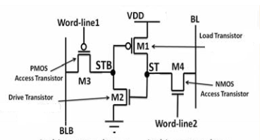
4T SRAM cell

Slide 8
Cell Design Concept
Unlike 6T SRAM cell which has only one wordline, 4T SRAM cell uses two wordlines
When ‘1’ is stored in cell load and drive transistors are ON
When ‘0’ is stored in cell
Load and drive transistor are OFF
For data retention following condition must be satisfied
Ioff-NMOS-access > ISD-Load + IGate-Driver + IGate-Load
Ioff-PMOS-access > IDS-Driver + IGate-Driver + IGate-Load

Slide 9
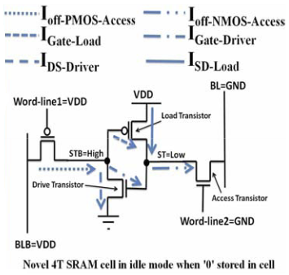
Cell Design Concept

Slide 10
Cell Design Concept
Leakage current of access transistors is used
Low threshold is used for access transistors
High threshold is used for load and drive transistors to reduce their sub-threshold currents

Slide 11
Leakage current
Leakage current in ‘1’ state is greater than in ‘0’ state
Leakage current of 6T SRAM cell when ‘0’ or ‘1’ stored is approximately equal to leakage current of 4T SRAM cell when ‘1’ is stored
Leakage current of 4T SRAM cell when ‘0’ is stored is much smaller than leakage current of 6T SRAM cell when ‘0’ is stored

Slide 12
Dynamic power consumption
In idle mode BL and BLB maintained at GND and VDD, hence no transition in writing ‘0’
Power consumption of writing ‘0’ is smaller than writing ‘1’ whereas in 6T both are same
Power consumption of reading ‘0’ and ‘1’ is smaller than in case of 6T

Slide 13
Advantages
Cell size of 4T SRAM is 20% smaller than that of conventional 6T SRAM cell
Reduction of 40% and 20% in static and dynamic power consumption is achieved
Disadvantages
Increase in delay
Less static noise margin(SNM)

Slide 14
2. Title:
Stefan Cosemans, Wim Dehaene and Francky Catthoor, “A Low-Power Embedded SRAM for Wireless Applications”, IEEE Journal of Solid- State circuits, Vol. 42, No. 7, July2007
Performance improvement is achieved by the use of four new techniques
Short buffered bitlines and efficient memory data bus
Exploitation of the dynamic read stability of SRAM cells
Low-swing write technique
Distributed decoder

Slide 15
Short Buffered Bitline Technique
Cell read current Iread,cell must create a large enough voltage difference on bitlines
Large capacitance of bitlines has a significant effect on memory access delay
Increasing Iread,cell increases leakage currents
A nominal value of Iread,cell becomes important
Due to small size of cells, intra die variations of Iread,cell will be large
Energy consumption and delay is increased

Slide 16
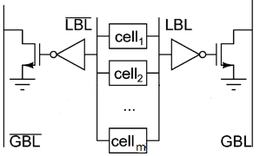
Short Buffered Bitline Technique
Amount of charge cell must draw from bitline is reduced
Bitline is divided into shorter local bitlines ( LBL)
Capacitance reduces, hence delay is reduced
Buffer is inserted between local and global bitlines (GBL)
Inverter acts as a sensing element for the buffer

Slide 17
Short Buffered Bitline Technique
Buffer consists of a scaled up NMOS transistor
Iread,buffer can be much lager than Iread,cell and suffers less from intra-die variation
Low voltage power supply can be used as precharge voltage to the GBL which reduces power consumption

Slide 18
Impact on Memory Databus
In traditional designs, amplification at the column level is required to limit Iread,cell impact on memory speed
In buffered bitline approach, buffer can easily deliver more current
Global bitlines can be extended to memory output
Only one set of sense amplifiers is required for entire memory
Area overhead is reduced

Slide 19
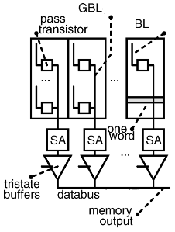
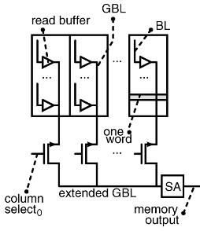
Impact on Memory Databus
Traditional solution
Proposed solution

Slide 20
Advantages
Reduction in delay
Reduction in power
Disadvantages
Increase in area overhead

Slide 21
Summary
Proposed 4T SRAM cell design is used in implementation of cache memory
Delay is increased
Buffered bitline technique is applied on 4T SRAM cache memory to reduce the delay

Slide 22
PROJECT WORK

Slide 23
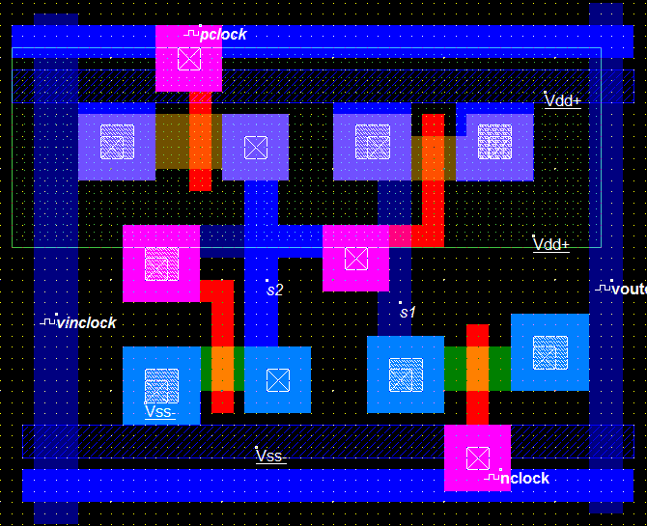
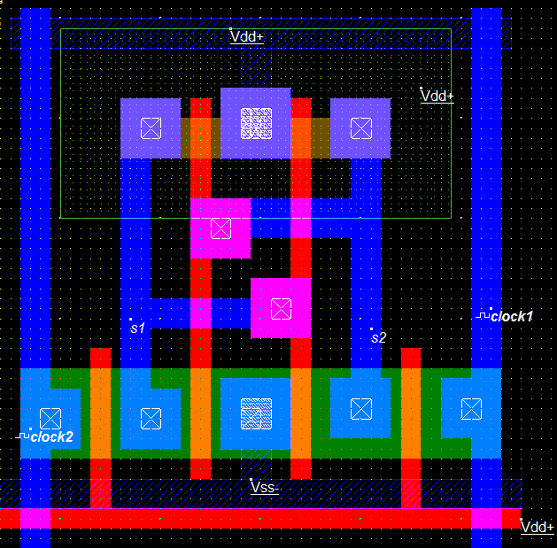
Work done
1. Layouts for 4T SRAM and 6T SRAM using Microwind
4T SRAM cell 6T SRAM cell

Slide 24
2. Comparisons for 4T and 6T SRAM cells
Freq | 6T
 | Power(uW)
500MHZ | 0.131
1GHZ | 0.198
1.25GHZ | 0.232
2.5GHZ | 0.402
5GHZ | 0.737
10GHZ | 1.381
20GHZ | 2.613
33.33GHZ | 4.136
4T
Power(uW)
0.066
0.066
0.073
0.159
0.308
0.575
1.002
Distorted output
Propagation delay for 6T SRAM cell is 5pS
Propagation delay for 4T SRAM cell is 8pS

Slide 25
3. Conclusions
A power reduction of 60-70% is obtained in 4T when compared to 6T SRAM
Power consumption increases with increase in operation frequency for both the cells
Propagation Delay of the cell is 60% more in 4T SRAM

Slide 26
Work to be done
Implementation of cache memory of size 8x16 using both 6T and 4T SRAM cells
Implement buffered bit line technique to reduce the delay of 4T SRAM cache
Compare results in terms of power and delay

Slide 27
Work plan
January | Literature survey
February | Literature survey tool selection cell design
March | Architecture and implementation of cache memory using 4T and 6T SRAM
April | Implement Buffered bit line technique Comparison of results Documentation
May | Documentation and presentation

Slide 28
References
Arash Azizi Mazreah, Mohammad Noorollahi Romani, Mohammad Taghi Manzuri, Ali Mehrparvar, “A low power and high density cache memory on novel SRAM cell”, IEICE Electronics Express, Vol.6, August 2009
Stefan Cosemans, Wim Dehaene and Francky Catthoor, “A Low-Power Embedded SRAM for Wireless Applications”, IEEE Journal of Solid- State circuits, Vol. 42, No. 7, July2007
A. Karandikar and K. K. Parhi, “Low power SRAM design using archical divided bit-line approach,” in Proc. Int. Conf. Computer sign: VLSI in Computers and Processors, 1998, pp. 82–88.

Slide 29
Thank you

Slide 30
Questions?

